Slide 1
Non Inverting Amplifier
Diego E Garcia
12/16/23 Prater RBT125

Slide 2
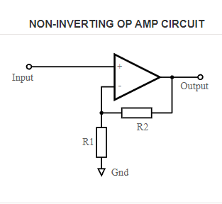
Notes:
The following circuit is a Non-Inverting OP AMP Circuit. This circuit consists of many parts the most important being the comparator. A key aspect of this circuit is that the input of the circuit goes into the positive of the comparator. If the input does not then the circuit will become a Inverting OP AMP Circuit which will be discussed in future slides detail. As the figure detailed demonstrates, the circuit often uses 2 resistors which are connected via the comparator negative connector. Not every Non-Inverting OP AMP Circuit utilizes 2 resistors, however it is important to have 2 components in their stead which provide a change in resistance. While this circuit can be used on it’s own for a pulsing LED similar to this course’s prior 555 timer lesson, it can also be used for other application which will be described in future slides. On top of being able to switch out the resistors of this circuit you may also include multiple outputs depending on the needs of your circuit.

Slide 3
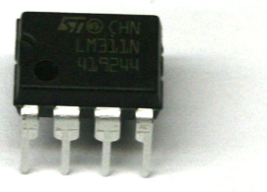
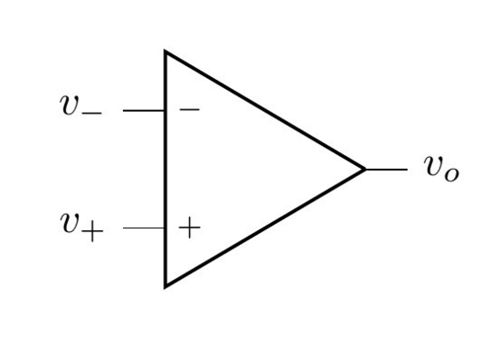
Function
Put simply a Non-Inverting Amplifier is an op-amp circuit which is a high-gain amplifier that has low input impedance and high output impedance.
The circuit’s core centers around the use of a comparator which as the name implies compares the stronger (or rather needed) voltages between 2 one will be represented by a Negative ground signal.
Notes:
The function of the Non-Inverting Amplifier as mentioned previously is to introduce a pulsing mechanic to a circuit. A Non-Inverting Amplifier as described in the slide above is used in order to obtain or compliment a high gain amplifier (as it is one). This circuit is favored, because it has a low input impedance and High output impedance. In the next slide some of the usages of circuit with such properties will be elaborated upon. As mentioned in the previous slide the core of the circuit is the comparator which is very much like a class demonstration covered in this course via the 555 timer. For the transistor to be functional the typical schematic requires 2 resistors as the transistor in use compares two different voltage values one being positive and the other negative. It is important to keep in mind that if a component on the output end of the schematic is polarized its functionality will have varying effects.

Slide 4
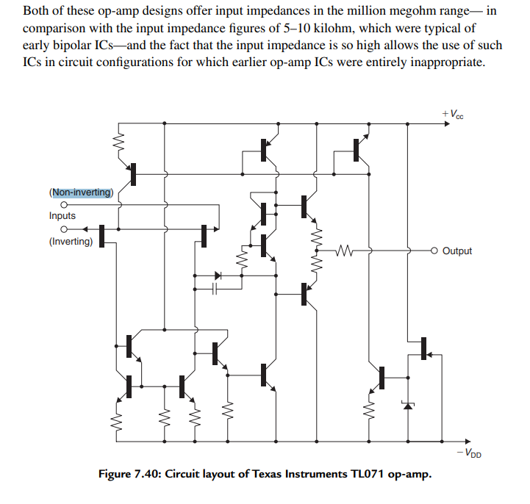
Usages
It is used to perform mathematical simulation like as its effects on waves
Used in Audio devices. While a little more uncommon, the rightmost figure demonstrates the need for a non-inverting signal for a 5-10Kilo ohm range via an OpAmp signal.
Notes:
The Non-inverting Amplifier circuit is utilized in a variety of day to day appliances as well as highly specialized machinery. While not technically utilized in a appliance, one uses of the Non-Inverting Amplifier circuit is to provide mathematical simulations. The non-inverting Amplifier circuit is optimal for mathematical studies and simulations as its effects on waveforms are consistent and easy to replicate. Some examples of highly specialized machines that use this circuit include, medical equipment including EEG (electroencephalogram) amplifiers and ECG (electrocardiogram). Other more common day to day utilities include thermostats, home security sensors, television sets, and various audio devices. As demonstrated in the slide’s rightmost figure their is a example of a modified Non-inverting amplifier which is being used in an audio device. The audio device in question is a speaker. As one might expect the use of different amplifiers such as a inverting or Non-inverting circuit can affect the clarity of the speaker.

Slide 5

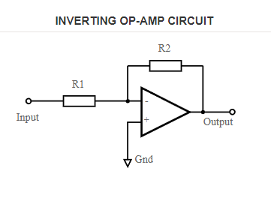
Advantages of circuit compared to others
Non inverting OP amp gain (such as what is used by a NON inverting Amplifiers) is calculated with the formula described to the right.
This formula is advantageous considering it will result in a higher theoretical Gain/Av compared to other circuits such as in the figure to the right. Typically gain is similar but this factor should be considered
Notes:
Non-inverting Amplifier circuits, have some advantages when compared to other circuits such as the inverting Amplifier circuit. One of many advantages that the Non-inverting Amplifier circuit has is that it’s results have a great tendency to fall in line with its theoretical calculated gain values. At the topmost figure the formula used to calculate the gain is represented and written as follows Av=1+R2/R1. While similar to a inverting amplifier circuit the formula for the Non-inverting amplifier current has a numerator of 1+r2. The use of a 1+R2 means that although typically similar in gain if resistor values are equal in both circuits then the Non-inverting Amplifier current would have a higher gain result then the inverting amplifier current. As mentioned in the previous slide the stability of the current is also admirable which makes it a prime candidate for utilization in simulations, and mathematical analysis compared to other similar circuits. While many circuits perform the same end function how it performs the function should always be considered.

Slide 6

Disadvantages of circuit compared to others
Depending on the goal of your circuit a inverting amplifier may be preferable rather than a non-inverting amplifier.
It may be preferable because as the name implies the inverting amplifier inverts or flips the signal so that positive voltage being input represents as a negative going one of the output/ out the other end of the circuit. Vise versa applies as well which is what causes the pulsing in both circuits.
Notes:
While the Non-inverting Amplifier circuit has many advantages it is important to remember not to neglect or overlook some of the circuit’s inherent flaws, or disadvantages. No circuit is perfect, but for a circuit the Non-inverting Amplifier circuit has relatively manageable disadvantages which in some circuits could be considered total advantages. In the instances in which a Non-inverting amplifying circuit or a modified version of it is not functional for your particular circuit, a inverting amplifier circuit might be recommended. The Inverting amplifier as mentioned previously has lower gain management which may be exactly what your circuit needs. Additionally a non-inverting Amplifier circuit does not flip the charge/polarity of the signal/current passing through it, with certain audio devices there may be too much interference. If you do not flip the charge/polarity of the signal/current when needed you may have a nonfunctional circuit in a best case scenario, and in a worst case scenario some pole-sensitive components might break.

Slide 7
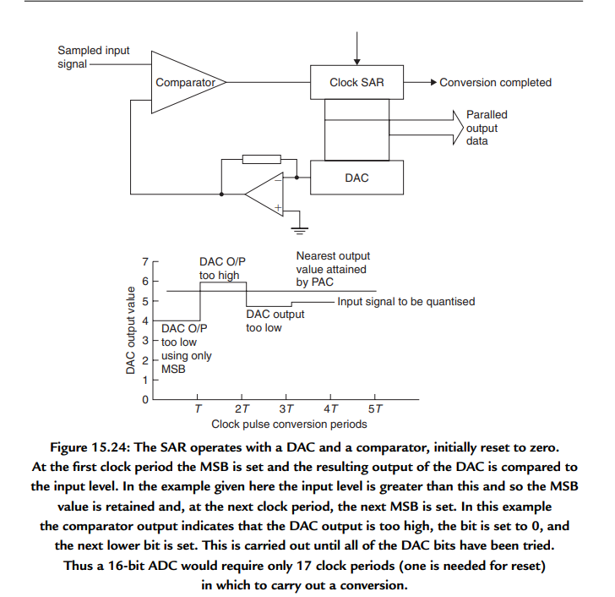
Variations of the circuit
Many of the variations may utilize
Multiple resistors (more than two)
Or may replace a resistor for a different component as can be seen within the figure the the right
Notes:
The Non-inverting Amplifier circuit has many variations, some of which are more complex than others. As mentioned previously many modifications to the Non-inverting Amplifying circuit change out one of the resistors, or have multiple outputs. To truly understand the difference between a modified Non-inverting Amplifying circuit, and a entirely different distinct circuit it is important to keep a few fundamentals in mind. The most fundamental rules for this circuit is that it make use of a comparator or adjacent component, and that there be at least two forms of significant resistance to the circuit. Without the comparator the circuit cannot complete it’s function of oscillating. Without significant resistance the comparator cannot operate as intended. In both instances of components being switched out the signal traveling through the circuit does not invert. As can be seen in the depicted circuit the second form of resistance in an audio device is another comparator. While this second comparator may invert the signal, the route provided by the resistor demonstrates that a non-inverted signal is maintained.

Slide 8
References
Agarwal, T. (2021, December 10). Non-inverting op-amp : Circuit, working, Examples &amp; Its Applications. ElProCus. https://www.elprocus.com/non-inverting-op-amp/
concordia college. (n.d.). Operational amplifiers - concordia college. https://faculty.cord.edu/luther/physics225/lectures/opamp.pdf
J, P. (n.d.). Schematic symbol of comparator | download scientific diagram - researchgate. Researchgate.net. https://www.researchgate.net/figure/Schematic-symbol-of-comparator_fig1_317232011
Notes, E. (n.d.). Inverting vs non-inverting OP amp circuits. Electronics Notes. https://www.electronics-notes.com/articles/analogue_circuits/operational-amplifier-op-amp/inverting-vs-noninverting-opamp-circuits.php
Prater, M. (n.d.). Noninverting amplifier. Prof. Prater’s Page. https://praterma2.github.io/cards/src/noninverting_amplifier.html
Self, D. (n.d.). Nvhrbiblio.nl. www.nvhrbiblio.nl. https://nvhrbiblio.nl/biblio/boek/Self%20-%20Small%20signal%20audio%20design-2e.pdf

